Slide 1
Publicis Sapient Logo

Slide 2

Cookie Less World

Slide 3
Agenda
What are Cookies?
What is the Buzz "Cookieless World"?
The Impact for Analytics Use Cases
Cookieless: Challenges or Opportunities
Adobe's Approach
Google's Approach
Meta's Approach
Future Proof Stratergy

Slide 4
What are Cookies?

Slide 5
Cookie – Back to Basics
Cookies are small pieces of data that web servers pass to your browser when you visit a site. The cookie collects data about the user (e.g., logins, browsing behavior, site visits, etc.) which brands can then use to market to this user. A cookie typically has the following parameters:
Information to be stored
Expiration time (in date format)
Domain on which cookie is created

Slide 6
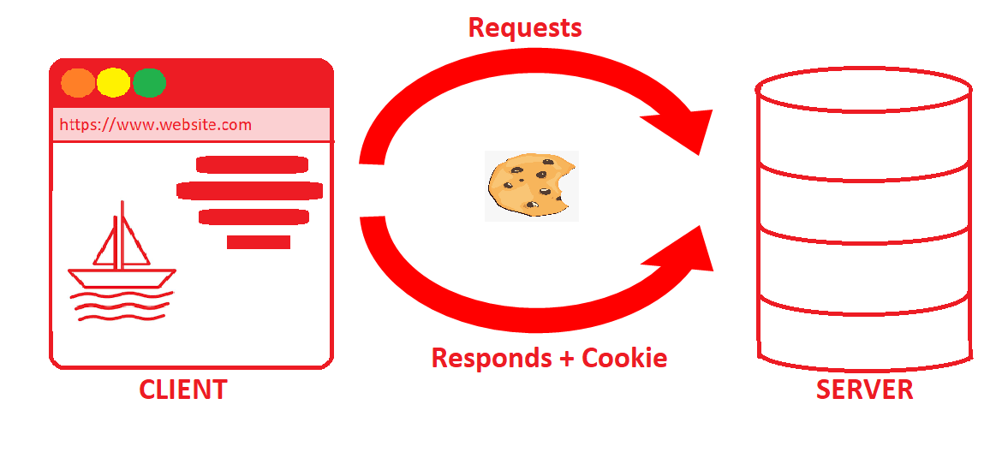
First Party Cookie
First-party cookies are directly stored by the website you visit. These cookies allow website owners to collect analytics data, remember language settings perform other useful functions that provide a good user experience.

Slide 7
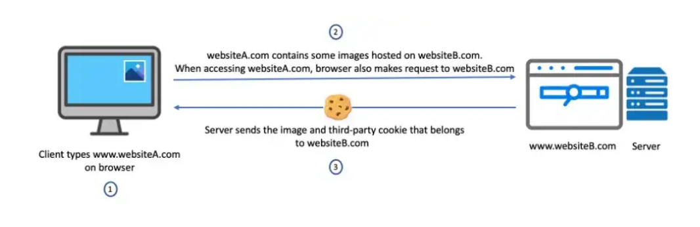
Third Party Cookie
Created by a 3rd party domain/advertiser. These are used for retargeting, cross-domain tracking, programmatic ad serving.

Slide 8
What’s the Buzz, Cookie less World?

Slide 9

What is Cookie-less?
Cookie less describes a way of marketing in which marketers are less reliant on cookies – bits of data that contain personal identifiers. Recent policy shifts by web browsers include the deprecation of 3rd party cookies for consumers’ privacy expectations and new privacy regulations. That’s why giants like Apple and Google are introducing new features that impact data collection for marketers.
The most important change is that all 3rd-party cookies will be deprecated by 2023.
This also impacts 1st-party cookies lifespan on Apple platforms.

Slide 10
ITP’s cookie update
What is ITP (Intelligent Tracking Prevention)| Apple iOS — 25% global market share
ITP (2017)
Targeted the use of 3rd party cookies.
ITP 2.1(Feb 21,2019)
All persistent client-side cookies, i.e. persistent cookies created through document.cookie, are capped to a seven day expiry.
ITP 2.2(April 24, 2019)
Capped 1st party Cookies tracked via Link Decoration to an eye-popping 1 day.
ITP 2.3(Sept 23, 2019)
Eliminated several workarounds, such as employing localStorage or using the JavaScript document.referrer property

Slide 11
ITP’s cookie update
CName
ITP limitations are also applied to cookies set via CNAME.
Currently both, Cookies set on the server-side via CNAME and Cookies set on the client-side via Javascript are limited to a seven-day (or) 24-hour expiry under ITP.
While a CNAME implementation does not provide any benefits in terms of Cookie lifetime, there may be some other benefits such as ad- blockers and less common browsers preventing data from being sent to domains they classify as trackers.
In those cases, using a CNAME may prevent data collection from being disrupted.

Slide 12
Google Chrome’s cookie update
Chrome’s Cookie Update |Google Chrome — 65% global market share
Jan 2020
Google has announced it will stop supporting 3rd party cookies on its dominant Chrome browser by 2022.
June 24, 2021
Google announced an updated timeline where they delayed plans to phase out 3rd party cookies in its Chrome browser until 2023.
July 2022
Google announces a new timeline for deprecating support for third-party cookies in Chrome in the second half of 2024.

Slide 13
Data Regulation
There are 2 major regulations that we have to account for, and though there are other countries coming up with their own versions (including India), but essentially, pretty much every regulation has similar flavor to it.
-GDPR: General Data Protection Regulation agreed upon and ratified by European Parliament
-CCPA: California Consumer Privacy Act, for California consumers
These regulations basically guarantee following rights to consumers of these geographies:
Right to be informed, Right of access, Right to rectification , Right to deletion, Right to restrict processing, Right to data portability, Right to object, Rights around automated decision making, Right to opt-out, Right to non-discrimination

Slide 14
Anything more we should know about Data Regulations
The most important part of these regulations is that most of the laws are territorial in nature, which means that every sovereign country can make laws affecting it’s people, which will be valid in the boundaries of that specific sovereign nation. In case of these data regulations though, these are extra territorial laws, which means that these regulations have to be followed by organizations outside the boundaries of the nations implementing these laws, and can also be enforced by various means.
Since the penalties of these laws can be really steep, so it’s imperative for us all to adhere to these regulations. For example, in case of GDPR, the fines can be in tune of 20 Million Euros or 4% of global revenue of the organization, whichever is higher.

Slide 15
Cookie-less: Challenges Or Opportunities?

Slide 16
Cookie-less Business Challenges
Blocking 3rd party cookies — an impetus for mar-tech, ad-tech, advertisers and publishers to retool their acquisition stack to eliminate dependency on Cookies.
Customer acquisition workflows such as 3rd party data-driven segmentation, and offsite retargeting will be compromised with diminishing of Cookies.
3rd party cookie deprecation impacts Cross-domain tracking, Ad Attribution and Cross-device Analytics. Brands will no longer be able to stitch data from anonymous users.
Shrinking 1st party cookie lifespan — Onsite journeys may appear fragmented for users on Apple’s platforms and Marketers may experience inaccurate attribution reporting.

Slide 17
Cookie-less Business Opportunities
For marketers, preparing for a cookie-less world means finding new ways to transform anonymous users into known customers.
Marketers are compelled to retool by replacing Cookie dependence with 1st party data. 1st party centricity requires the fusion of two data streams.
1st Party web/application/media data collected at scale in real-time.
Consumer-provided emails or phone numbers are given with consent to utilize for marketing purposes.
It’s also an opportunity to embark on a data revolution and redefine the modern relationship between customer and brand – one built on trust and respect.

Slide 18
Adobe’s approach

Slide 19
First Party Identity Infrastructure:
Event Forwarding
Notes:
https://support.google.com/google-ads/answer/11899856

Slide 20
Adobe’s Approach for cookie-less
Adobe’s Approach is centralized on 1st party data strategies and consumer trust for driving customer experience.
Consumer Trust: Governance and consent tools available to manage how identities are collected, when they can be used, and for what purpose
1st Part Data: Customer Operationalize their 1st Party data collection strategies on Adobe Experience Platform
Strategic Partnerships: Brand collaboration of 1st party audience in a secure, neutral environment.
Scalable Activation: The flexibility to Target audiences using multiple cookie-less identifiers to maximize reach
Content Marketing

Slide 21
First Party Identity Infrastructure:
Adobe suggests the market is being flooded with new IDs. Customers don’t need another ID. They need a technology stack that does the following:
Stitches together the various identities into a single unified profile.
Surfaces that profile in all the customer acquisition workflows that Marketers need.
The emergence of Adobe Experience Platform presents a unified hub that allows Brands to not only collate and house data from offline and online channels, but also stitch data to 1st party Identity to build a Profile that Marketers can use for personalization and other marketing activities without needing long term Cookies.

Slide 22
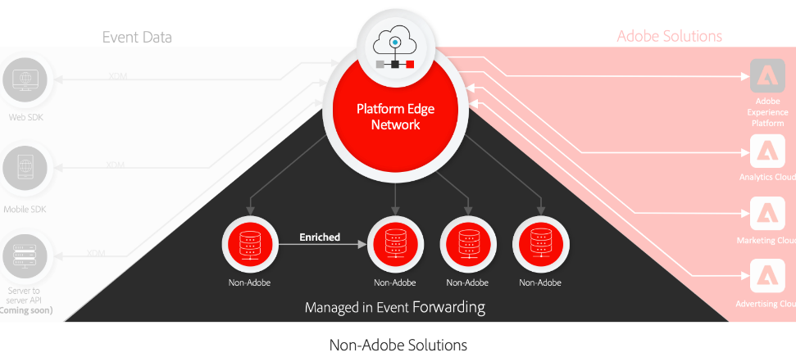
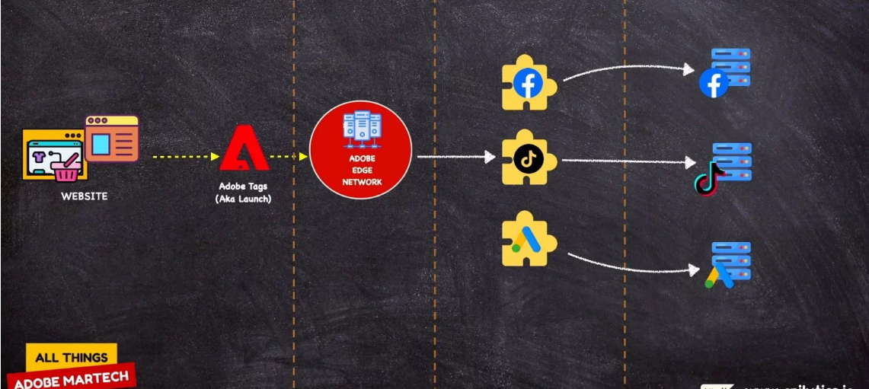
Event Forwarding:
Event forwarding in Adobe Experience Platform allows you to send collected event data to a destination for server-side processing. It decreases web page and app weight by using Adobe Experience Platform Edge Network to execute tasks normally done on the client.

Slide 23
Adobe Experience Platform
Adobe Real Time CDP
Collect B2C and B2B data from across systems, unify it into real-time profiles and create audiences that are ready for activation across any channel.
Adobe Customer Journey Analytics
Connect every customer touchpoint and visually explore comprehensive journeys in real time to give teams the insights they need to build incredible customer experiences at scale.
Adobe Journey Optimize
Manage scheduled omnichannel campaigns and one-to-one moments for millions of customers from a single application — and optimise the entire journey with intelligent decisioning and insights.

Slide 24
Google’s approach

Slide 25
Googles efforts on different areas
Google Privacy Centric Development
GTM Server-side
First party data strategy
Data clean rooms
Conversion Modelling

Slide 26
Google’s Privacy-Centric Developments
In 2019, Google unveiled the Privacy Sandbox, their initiative to meet rising consumer expectations for more privacy on the web. It leveraged a tracking method called Federated Learning of Cohorts (FLoC).
Instead of using third-party cookies to collect information about users’ browsing history, it analyses online activity within their Chrome browser.
But in January 2022, FLoC was disintegrated, and Google Topics rose in its place to support interest-based advertising and help businesses connect with potential customers in a more private way.
Notes:
https://support.google.com/google-ads/answer/11899856

Slide 27
Why Floc was a failure?
The main concern was that FLoC facilitated fingerprinting – a practice in which a third party secretly gathers small pieces of data about a user’s device in order to build up a unique profile for that user, which can then be used to track them online.
Examples of this data could be device and app preferences, language settings, or location. Such small pieces of information might seem relatively useless individually, but when enough of these are combined, they can create astonishingly accurate profiles.
Unlike third-party cookies, fingerprinting data is not stored on the user’s device and therefore cannot be easily deleted.
The argument against FLoC was that, while trackers would ordinarily have to begin profiling an individual from a pool of millions, by placing them in a cohort based on their browsing activity, FLoC would narrow that figure down to just a few thousand, effectively doing a large amount of the initial legwork.
Notes:
Google Topics API: Everything you need to know - SmartFrame

Slide 28
Interest-based advertising
Interest-based advertising (IBA) is a form of personalized advertising in which an ad is selected for a user based on their interests, inferred from the sites they've recently visited. This is different from contextual advertising, which aims to match content on the page the user is visiting.
IBA can help advertisers to reach potential customers and help fund websites that cannot otherwise easily monetize visits to their site purely via contextual advertising. IBA can also supplement contextual information for the current page to help find an appropriate advertisement for the visitor.
Notes:
https://support.google.com/google-ads/answer/11899856
https://www.privacysandbox.com/news/maximize-ad-relevance-after-third-party-cookies/

Slide 29
Topics API
The Topics API proposes a way to provide topics that a user might currently be interested in, based on their recent browsing activity. These topics can supplement contextual information to help select appropriate advertisements.
The Topics API has three main tasks:
Map website hostnames to topics of interest. For example, a yoga website might be classified as being related to "Fitness".
Calculate the top topics for a user based on their recent browsing activity.
Provide a JavaScript API to provide topics currently of interest to the user, to help select the appropriate ads.
The Topics API can help facilitate robust user controls, as the API is built on top of recognizable, high-level topics. Chrome plans to offer users the option to remove individual topics, and to show the user the topics stored in the browser.
This API is particularly useful for ad tech that doesn’t have direct publisher relationships or contextual optimization capabilities.
Notes:
https://support.google.com/google-ads/answer/11899856
https://www.privacysandbox.com/news/maximize-ad-relevance-after-third-party-cookies/
https://developer.chrome.com/docs/privacy-sandbox/topics/

Slide 30
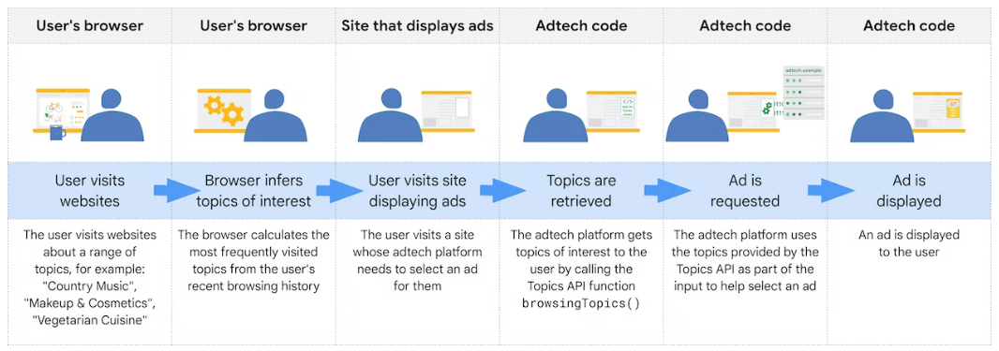
Topics API Lifecycle

Slide 31
Fledge API
FLEDGE is a Privacy Sandbox proposal to serve remarketing and custom audience use cases, designed so that it cannot be used by third parties to track user browsing behavior across sites. The API enables on-device auctions by the browser, to choose relevant ads for websites the user has previously visited.
FLEDGE is the first experiment to be implemented in Chromium within the TURTLEDOVE family of proposals.
Interest groups: stored by the browser, with associated metadata to configure ad bidding and rendering.
On-device bidding by buyers (DSP or advertiser): based on stored interest groups and signals from the seller.
On-device ad selection by the seller (SSP or publisher): based on auction bids and metadata from buyers.
Ad rendering in a temporarily relaxed version of Fenced Frames: with network access and logging allowed for ad rendering.

Slide 32
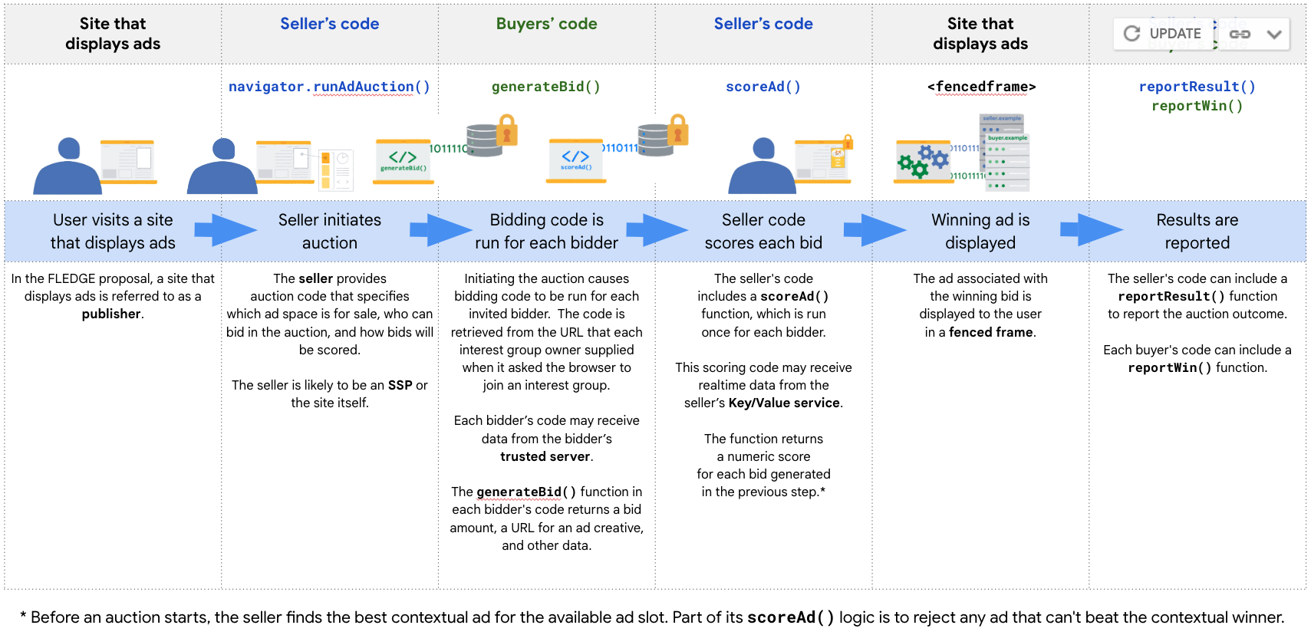
Fledge API Lifecycle

Slide 33
Attribution Reporting API

Slide 34
Server side Tagging
Server-side tagging allows you to move measurement tag instrumentation from your website or app to a server-side processing container on Google Cloud Platform (GCP), or any other platform of your choosing. Server-side tagging offers a few advantages over client-side tags:
Improved performance: Fewer measurement tags in your website or app means less code to run on the client side.
Better security: Visitor data is better protected and more secure when collected and distributed in a customer-managed server-side environment. Data is sent to a cloud instance where it is then processed and routed by other tags.

Slide 35
How does Server-side Tagging works?
Clients receive measurement data from a device
Clients transform request data into one or more events
Clients run the container
Clients package up the results to send back to the device

Slide 36
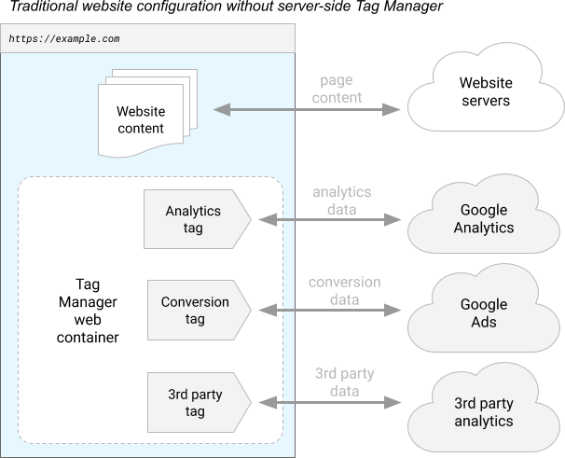
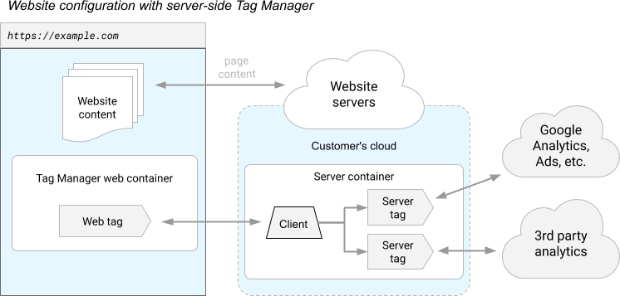
Website configuration without server-side Tag Manager
Website configuration with server-side Tag Manager
Vs

Slide 37
Meta’s Approach

Slide 38
Meta’s Solutions to a Cookie less Future:
For years, Brands have relied on the Facebook Pixel to understand how our ads are performing and build powerful retargeting audiences. But the power of the Facebook Pixel is dwindling due to iOS 14 privacy features and the demise of third-party cookies throws a wrench in the works for not only ad targeting, but also ad measurement. - Meta has introduced Server-side Conversion API (CAPI), that helps advertisers use their own marketing data to optimize ad targeting, decrease cost per action and more accurately measure campaign outcomes. - To help brands combat new measurement challenges, Meta is investing in advanced conversion modeling as it leverages non-identity-linked consumer data to quantify conversions.

Slide 39
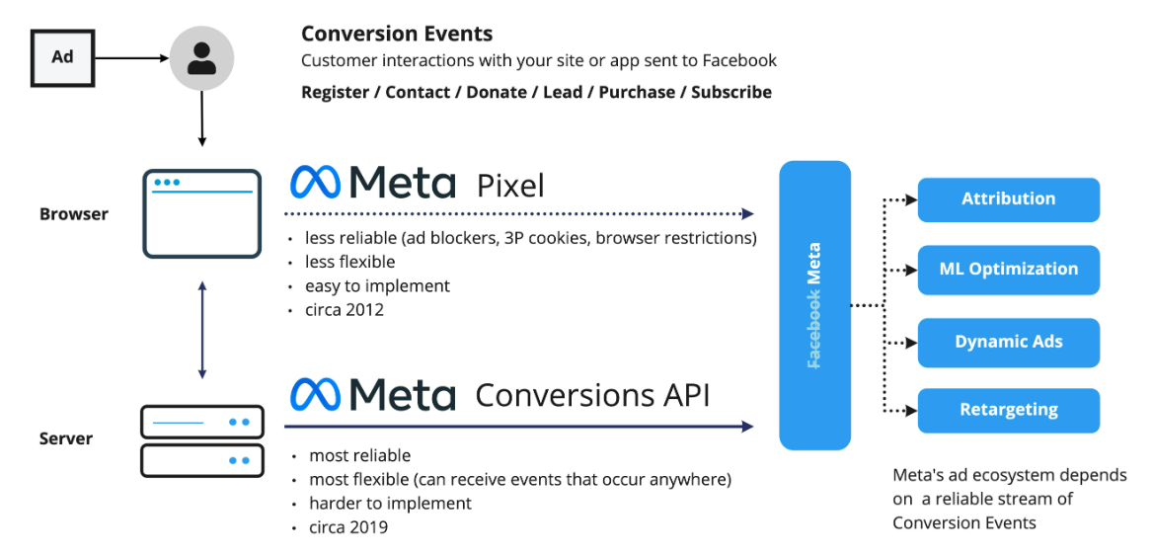
Meta’s CAPI
Conversions API is a Facebook Business Tool that lets you share key web and offline events, or customer actions, directly from your server to Facebook’s. This is built to honor people’s privacy preferences.

Slide 40
Future Proof Strategy

Slide 41
Strategy
To help brands combat new measurement challenges, it is important to leverages non-identity-linked consumer data to quantify conversions. There is no sense building or investing in any types of technologies that allow for continued tracking of users across the web.
We can take a couple of cues from the technology solutions discussed so far and focusing on the solution which is need to be adopted considering need of the hour:
Develop First Party Infrastructure
Adopt AdTech platform’s Conversion API (Will cover Separately)

Slide 42
First Party Data Infrastructure:
Building a first-party data strategy involves designing a plan to support the collection and application of first-party data — in other words, the information you receive consent for and collect directly from customers via your owned Platforms or channels.
With all of the information, where do you start? Here are five tips to help you think about your first-party data strategy:

Slide 43
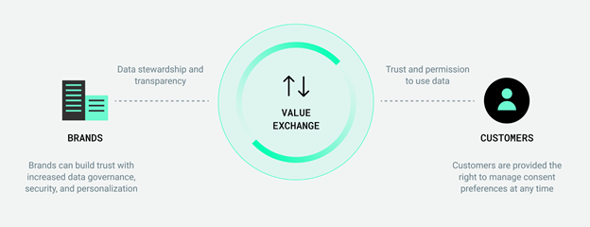
Collection
To successfully collect first-party data, you must create a data transaction that provides value for the customer and ensures trust by communicating transparency of use and responsible data governance.

Slide 44
Thank You
copyright publicis sapient | confidential

